Slide 1

Restaurant “La ö” goes big !
Market study of Montpellier, France for franchising a high-end sandwicherie

Slide 2
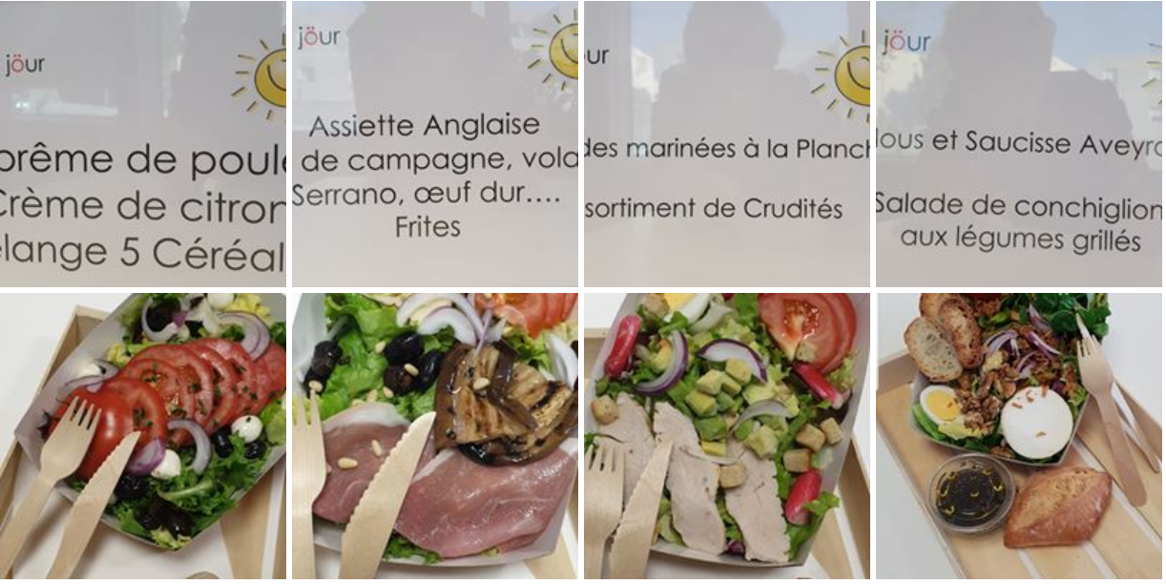
“La ö" restaurant could be turned out as franchise business into other Montpellier neighbourhoods?

Slide 3
Business problem
Where do we find neighbourhoods in Montpellier that are similar to the one where the restaurant "La ö“ is currently located?
What are the competitors that they may face in that similar neighbourhood?
What are the ratings of those competitors ?

Slide 4
Methodology
Stage 1: Identify the neighbourhood and their socio-economic data
Stage 2: Cluster (ML) the neighbourhoods to find the most interesting ones for another restaurant installation
Stage 3: Find competitor venues description from Foursquare
Stage 4: Compare with competitors

Slide 5

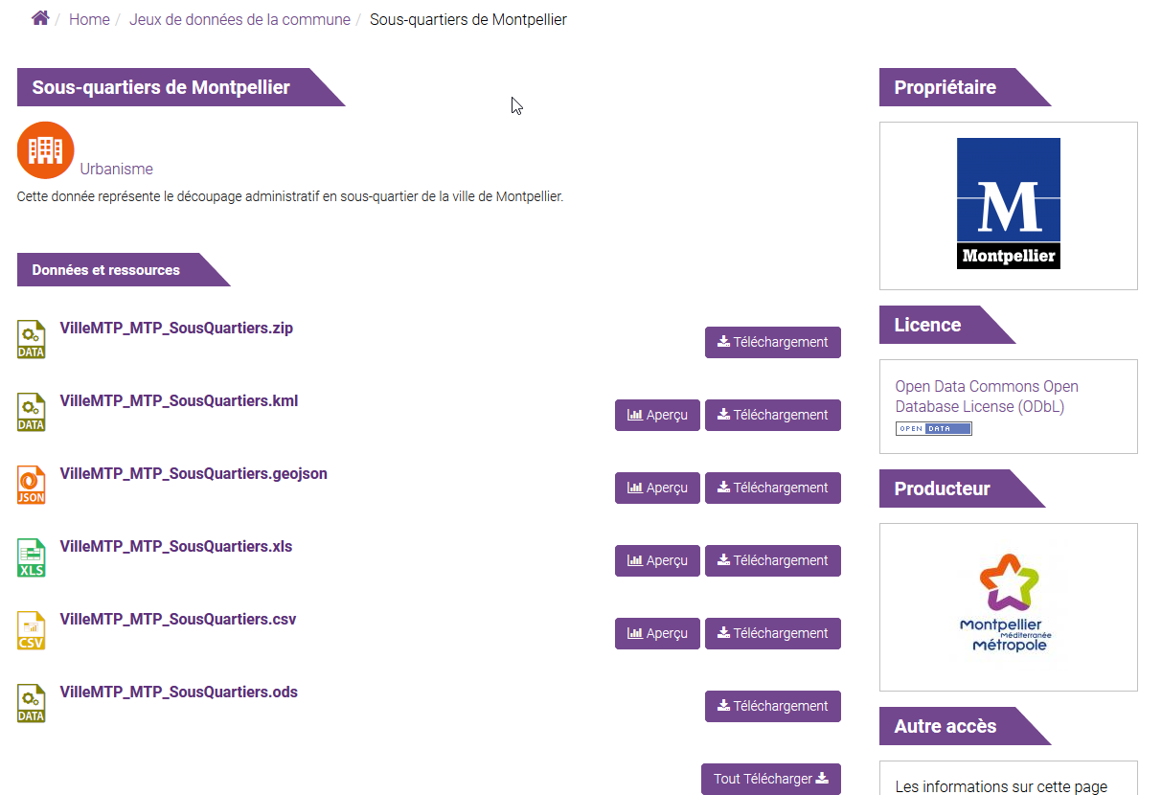
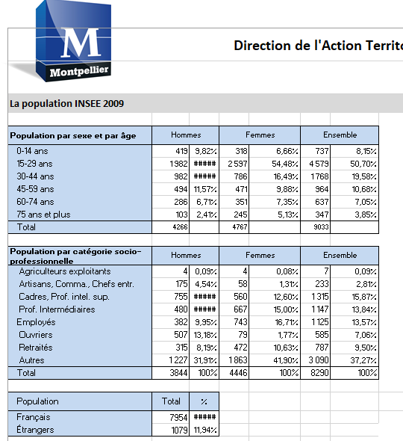
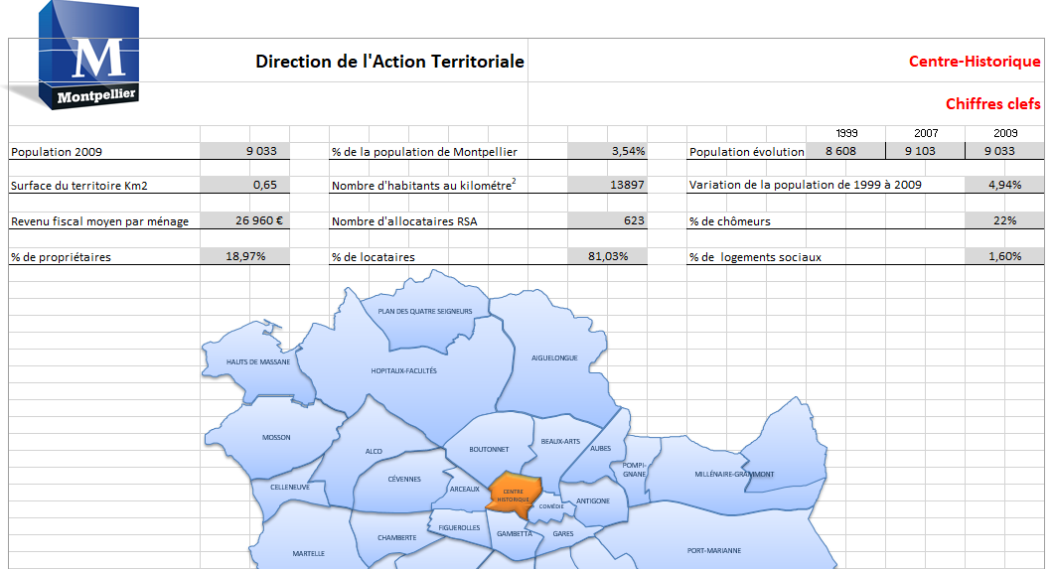

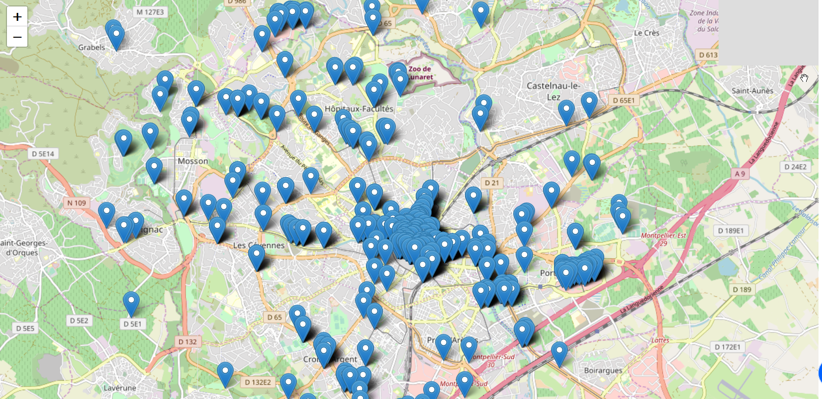
Data

Slide 6
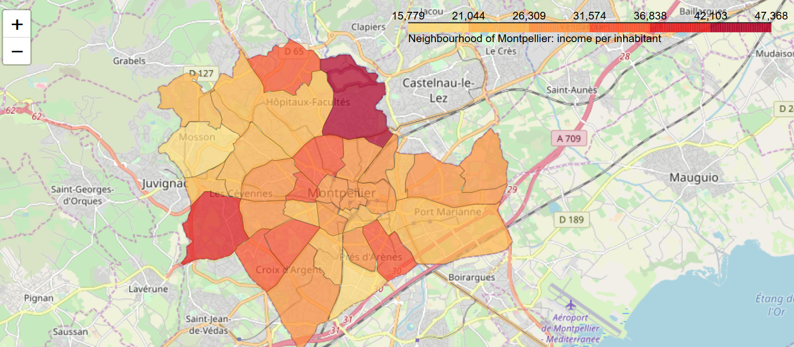
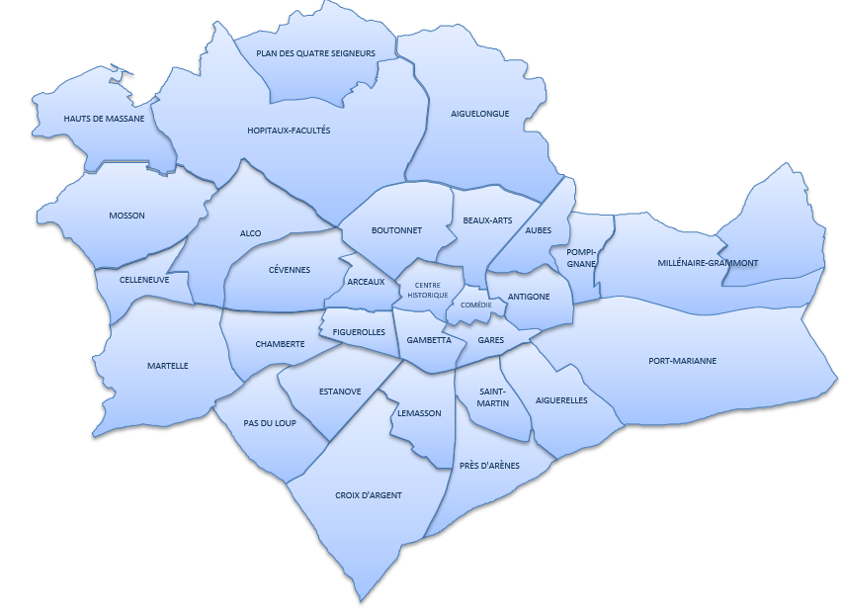
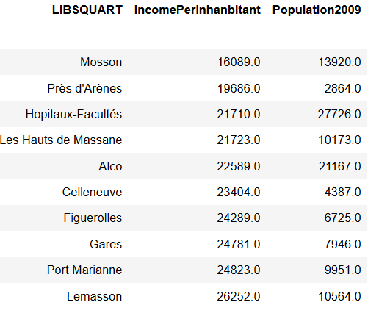
Descriptive analytics
Income per inhabitant
31 neighbourhoods
Restaurant “La ö” is into “Hopitaux-Facultés”

Slide 7
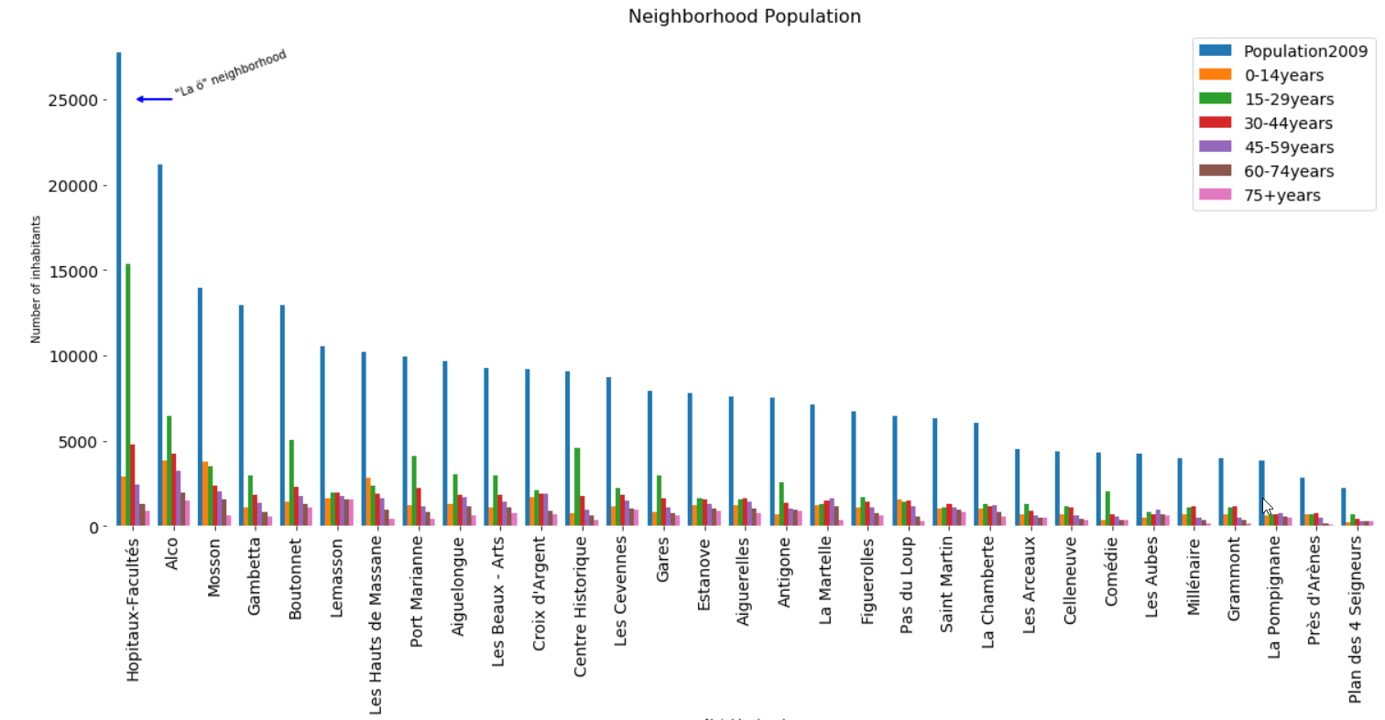
Descriptive analytics
Neighbourhood population

Slide 8
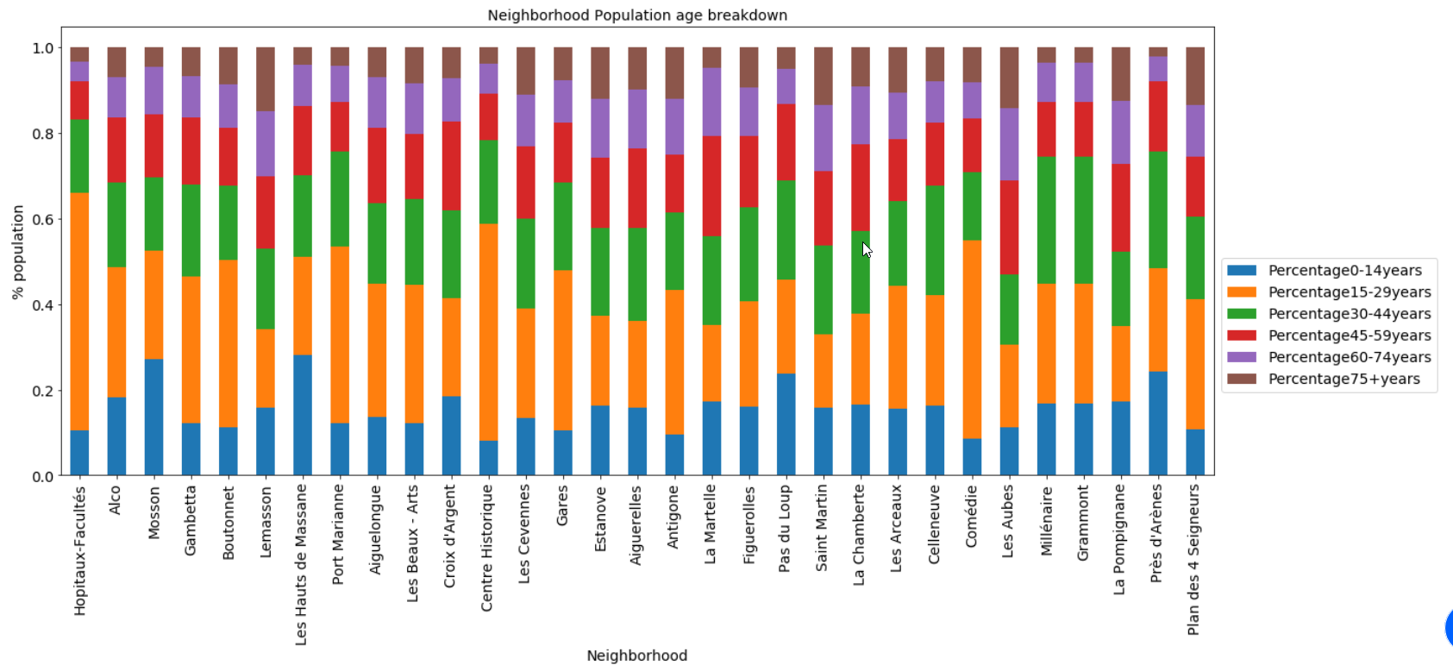
Descriptive analytics
Inhabitant age breakdown

Slide 9
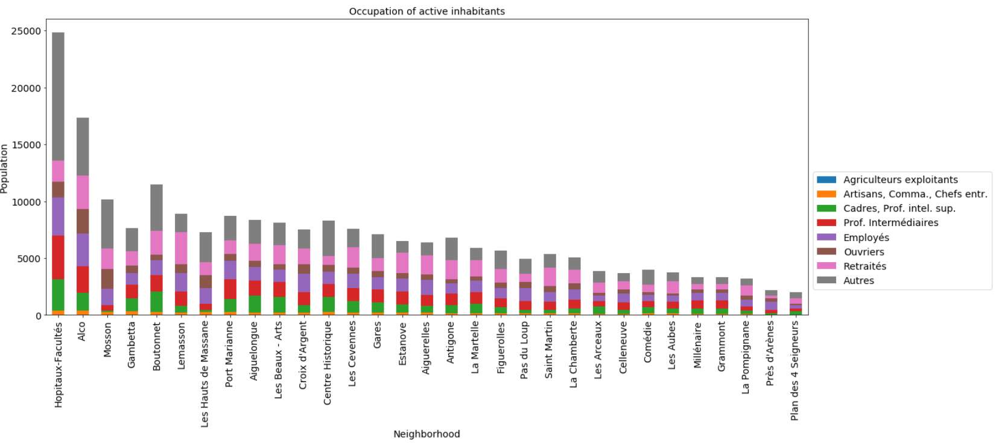
Descriptive analytics
Occupation of active inhabitants. “Other” includes students

Slide 10
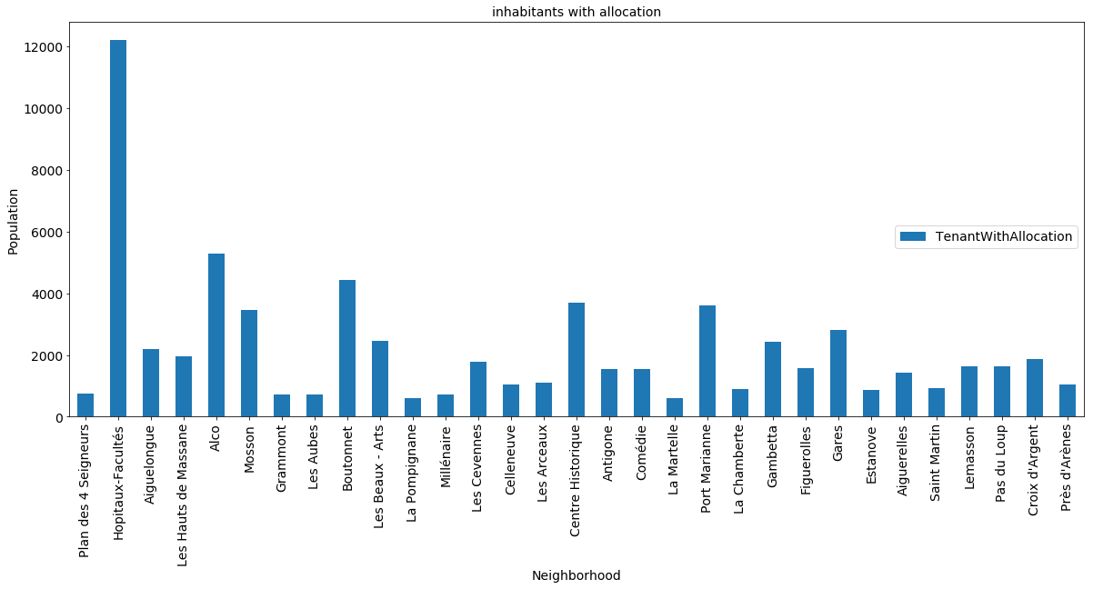
Descriptive analytics
Number of neighbourhood inhabitants with tenant housing allocation

Slide 11
Neighbourhoods long list
Alco, Mosson, Gambetta : because of the age and profession of inhabitant (including students)
Mosson, Alco, Près d’Arène, Les haut de Massane, Celleneuve : because of the income per capita

Slide 12
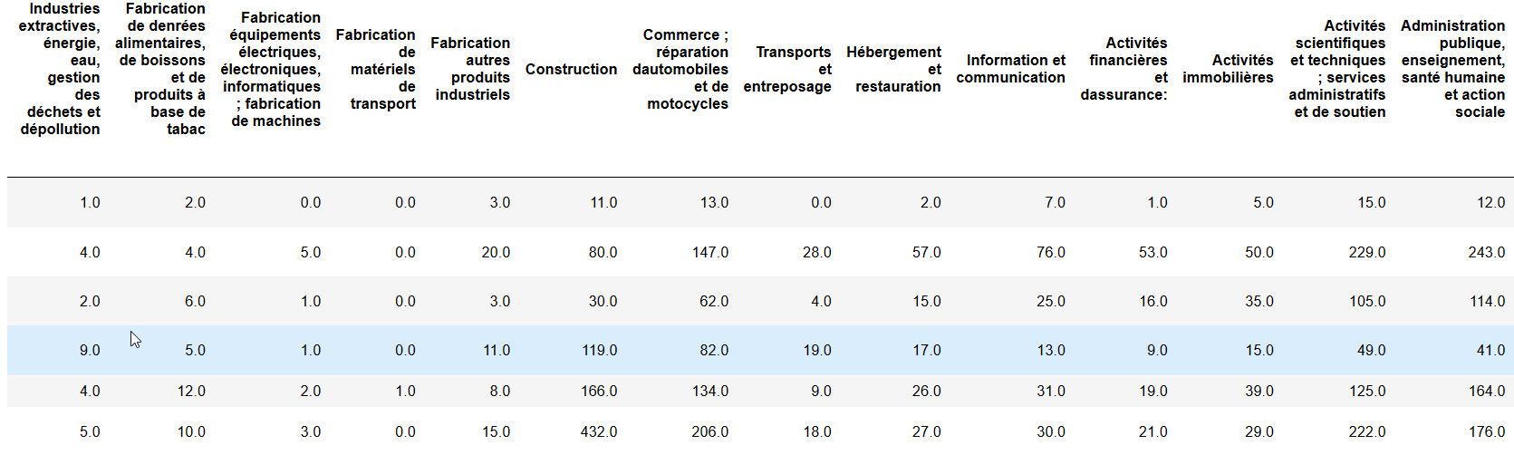
Kmeans Clustering
Number and types of service, shops and industries

Slide 13
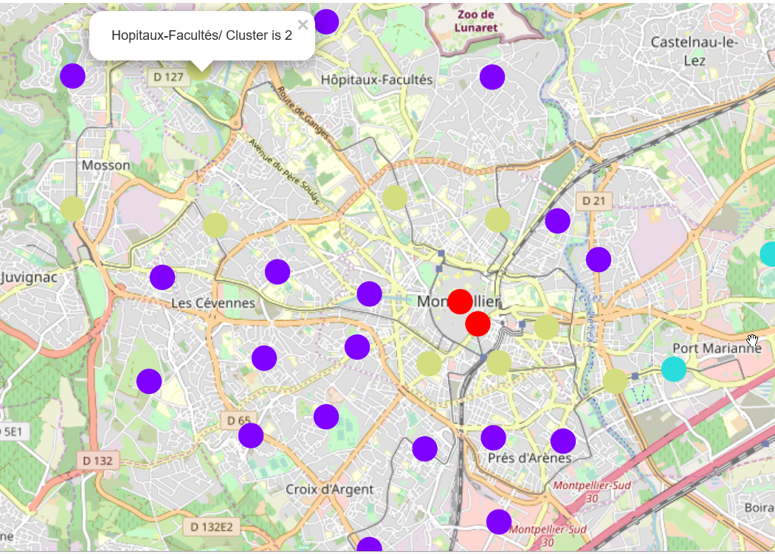
Kmeans Clustering: 4 centers
Cluster | Number of neighbourhoods | Neighbourhoods
0 | 18 | Plan des 4 Seigneurs, Aiguelongue, Les Hauts de Massane, Les Aubes, La Pompignane, Les Cevennes, Celleneuve, Les Arceaux, La Martelle, La Chamberte, Figuerolles, Estanove, Aiguerelles, Saint Martin, Lemasson, Pas du Loup, Croix d'Argent, Près d'Arènes
2 | 9 | Hopitaux-Facultés, Alco, Mosson, Boutonnet, Les Beaux - Arts, Antigone, Port Marianne, Gambetta, Gares
3 | 2 | Centre Historique, Comédie
1 | 2 | Grammont, Millénaire

Slide 14
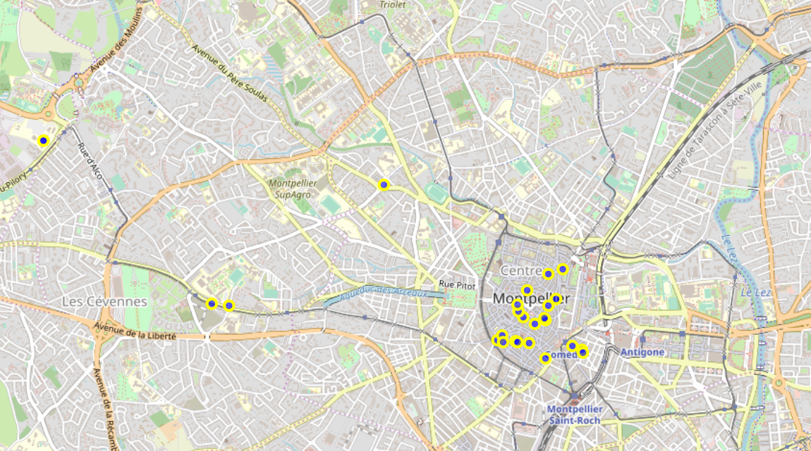

Neighbourhoods short list
From descriptive analytics & Clustering:
Alco, Mosson and Gambetta.
There are 27
competitor
restaurants
inside
Foursquare

Slide 15
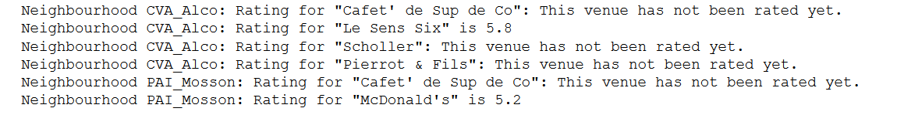
Neighbourhoods selected
There are a lot of restaurant in Gambetta. It is not a good idea to install where there are already many competitors. So let’s see the rating of the restaurants in the 2 others neighbourhood:
Alco, Mosson

Slide 16
Conclusion
Neighbourhood Alco seems a good place as the population and activities are the same as “Hopitaux-Facultés” where the restaurant is currently located. Moreover there are very few competitors there and there are also a lot of students that may become regular clients.
The drawback is that is that this neighbourhood is close to the current one. The bulk of customers may be too small to accommodate two restaurants.
The same analysis would be more useful if done with the neighbourhoods of other cities in France. But this is another story….

Slide 17
References
https://dataplatform.cloud.ibm.com/analytics/notebooks/v2/017b7cbd-6c7f-40d8-b58b-2442a9e6af2e/view?access_token=d45e0dca5aefd67d94d6f206d1cd5334484fa1a1f1198b332f283d45850f19c2
https://github.com/cspielmann/Coursera_Capstone/tree/master/capstone_final

